Slide 1
Project Title: FitSense
Code busters| CIEL Kingston vibeAIthon 2025
AI that senses your fitness..!

Slide 2
Problem Recap & Objective
Validated Problem Statement:
During the ideation stage, we identified that individuals performing home workouts often lack access to real-time feedback and personalized coaching. This results in poor posture, inefficient workouts, and increased injury risks.
Key Pain Points Addressed:
No affordable or intelligent fitness guidance for at-home users
Difficulty maintaining correct workout form and consistency
Lack of motivation and data-driven tracking

Slide 3
Prototype Objective:
To create a functional AI-driven fitness assistant that uses computer vision and NLP to detect posture errors, count workout repetitions, provide personalized fitness & diet guidance, and answer user queries via chatbot.
Expected Outcomes / Success Metrics:
≥90% accuracy in pose detection and rep counting
Instant feedback through voice and visual cues
Personalized recommendations based on body ratio and BMI
Engaging, user-friendly interface driving higher workout consistency

Slide 4
Prototype Overview
Prototype Description: FitSense is a fully functional AI-powered fitness platform built using Streamlit. It integrates real-time body tracking, posture correction, repetition counting, body ratio analysis, and an interactive chatbot — all within a single dashboard.
Technology Stack & Tools:
Frontend: Streamlit
Computer Vision: MediaPipe, OpenCV, NumPy
Voice Engine: Pyttsx3
NLP Layer: Sentence Transformers (MiniLM-L6-v2)
Data Processing: Pandas, Scikit-learn
Visualization: Streamlit UI components

Slide 5
Prototype Type:
Functional prototype — Live demonstration ready and fully executable.
Key Visuals to Include:
Dashboard Home Screen
Repetition Counter UI
Pose Correction Feedback (Good/Slouched posture)
Body Type & Diet Recommendation Panel
Chatbot Interaction Snapshot

Slide 6
User Experience & Impact
User Journey:
The user opens FitSense and selects their desired module (Repetition Counter / Pose Correction / Diet Recommendation / Chatbot).
For workout tracking, the webcam activates and detects movements in real-time.
FitSense counts reps and gives instant voice alerts (“Good posture”, “One, Two…”).
Users can upload their image or enter body stats to get personalized diet & workout plans.
The AI chatbot provides fitness and nutrition answers for quick guidance.
Key Features / Interactions:
🎥 Real-time posture & repetition tracking
🗣️ Voice-based form correction
📏 Body-type analysis with tailored fitness advice
💬 Intelligent chatbot answering health & nutrition queries

Slide 7
What Makes It Unique / Innovative:
Combines Computer Vision + NLP + Voice Feedback
Provides instant corrective feedback like a personal trainer
Works locally without internet dependency
Holistic approach: form + fitness + food guidance
Next Steps for Scaling:
Deploy as a mobile app for easy access
Integrate wearable sensor compatibility
Add progress tracking dashboard with analytics
Partner with gyms and trainers for real-world validation

Slide 8
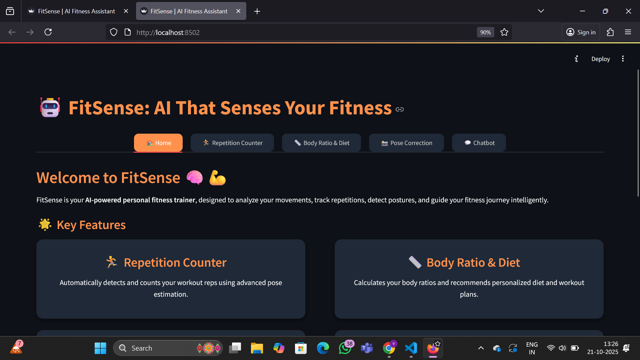
Prototype screenshots home page

Slide 9
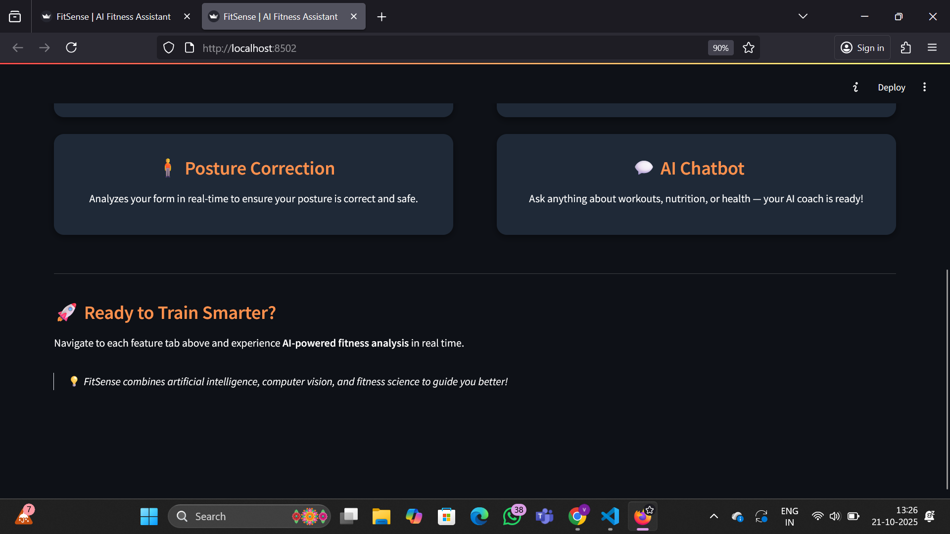

Slide 10
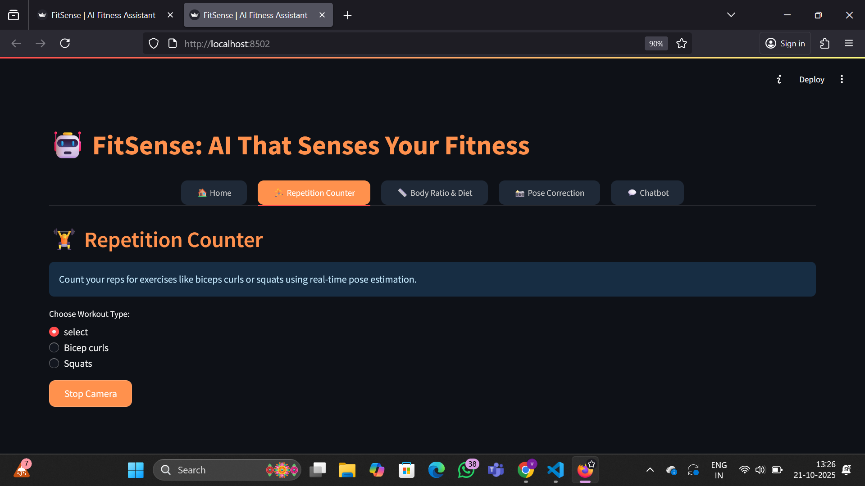
Repetition counter

Slide 11
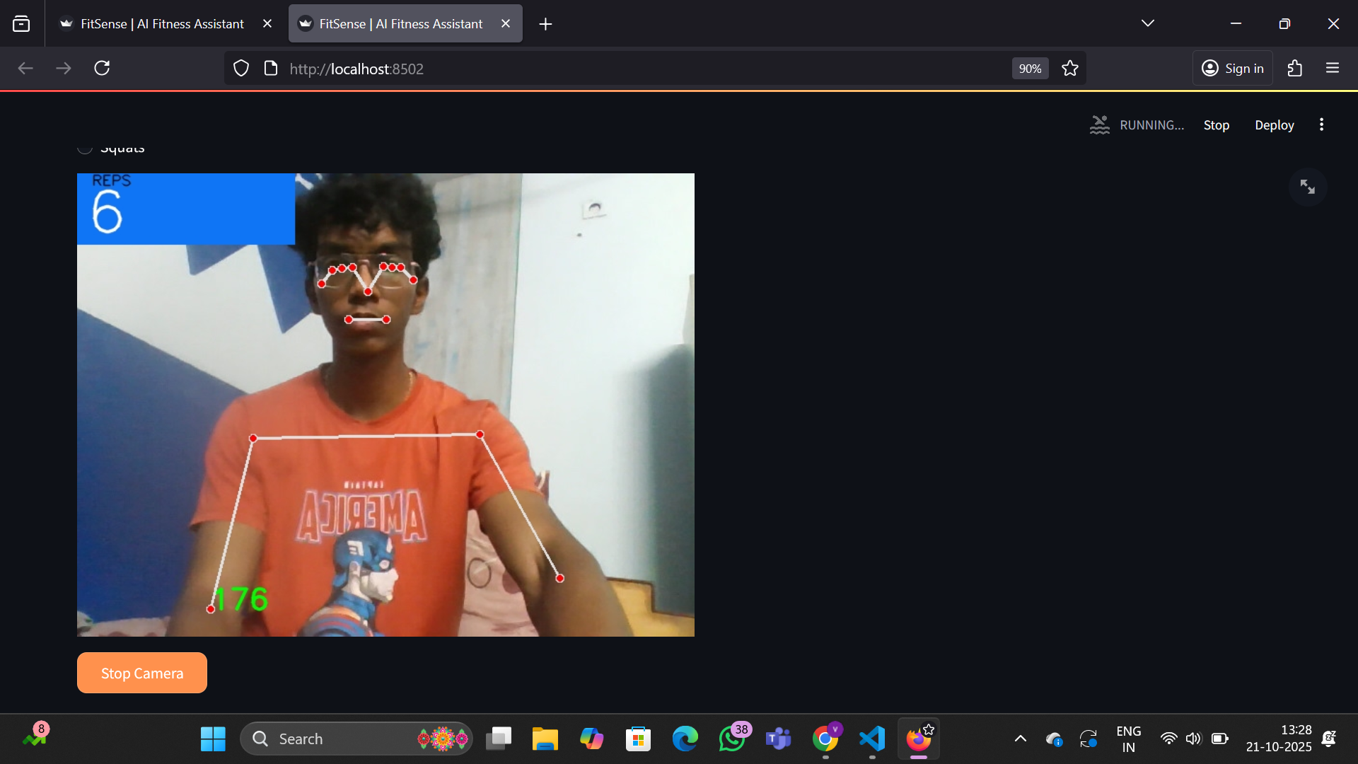
Counts the reps lively by angle computations.

Slide 12
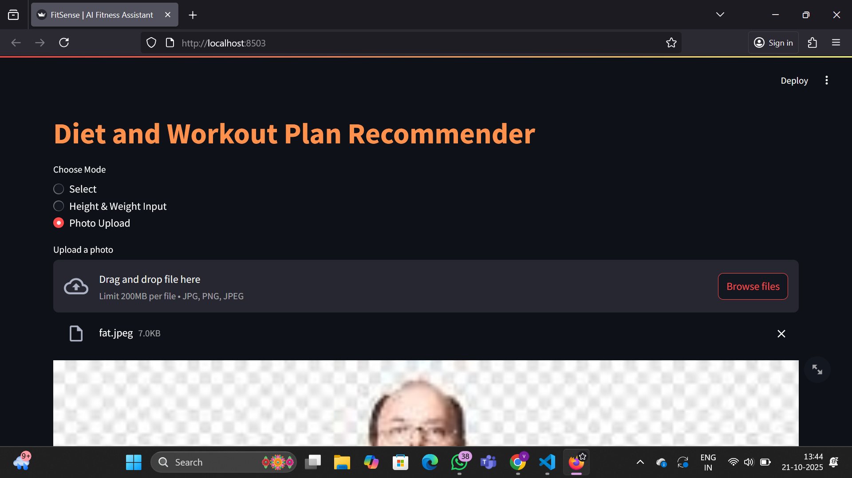
Diet and workout plan recommender

Slide 13
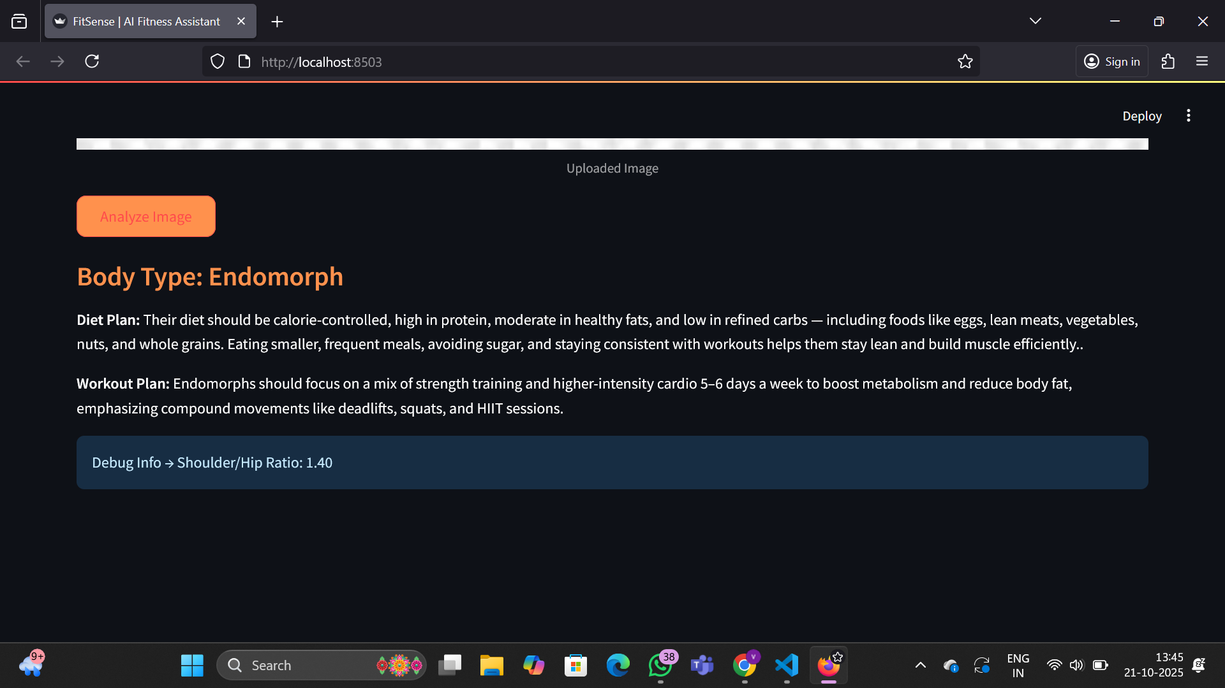
After clicking “analyze image” it provides the body type of the person, diet and workout plan and shoulder/hip ratio of that person.

Slide 14
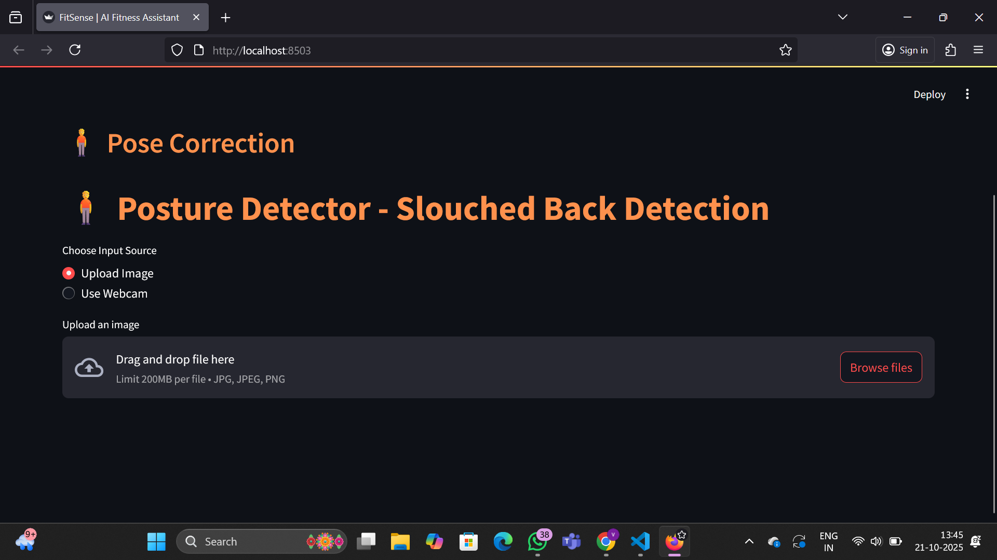
Posture detector
After uploading a image or live feed, It will detects the slouched back and gives warning beep sound with its risks. Also provides tip to correct the posture.

Slide 15
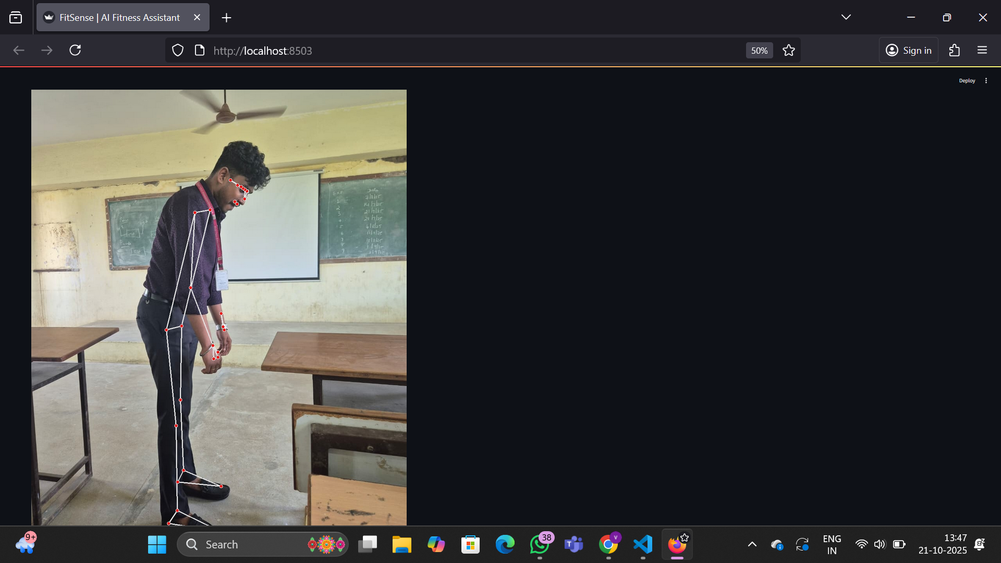
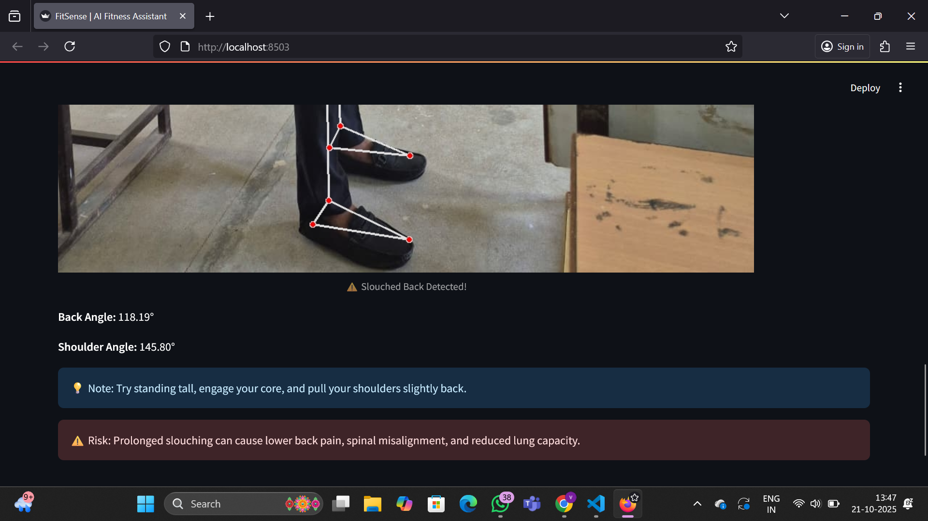

Slide 16
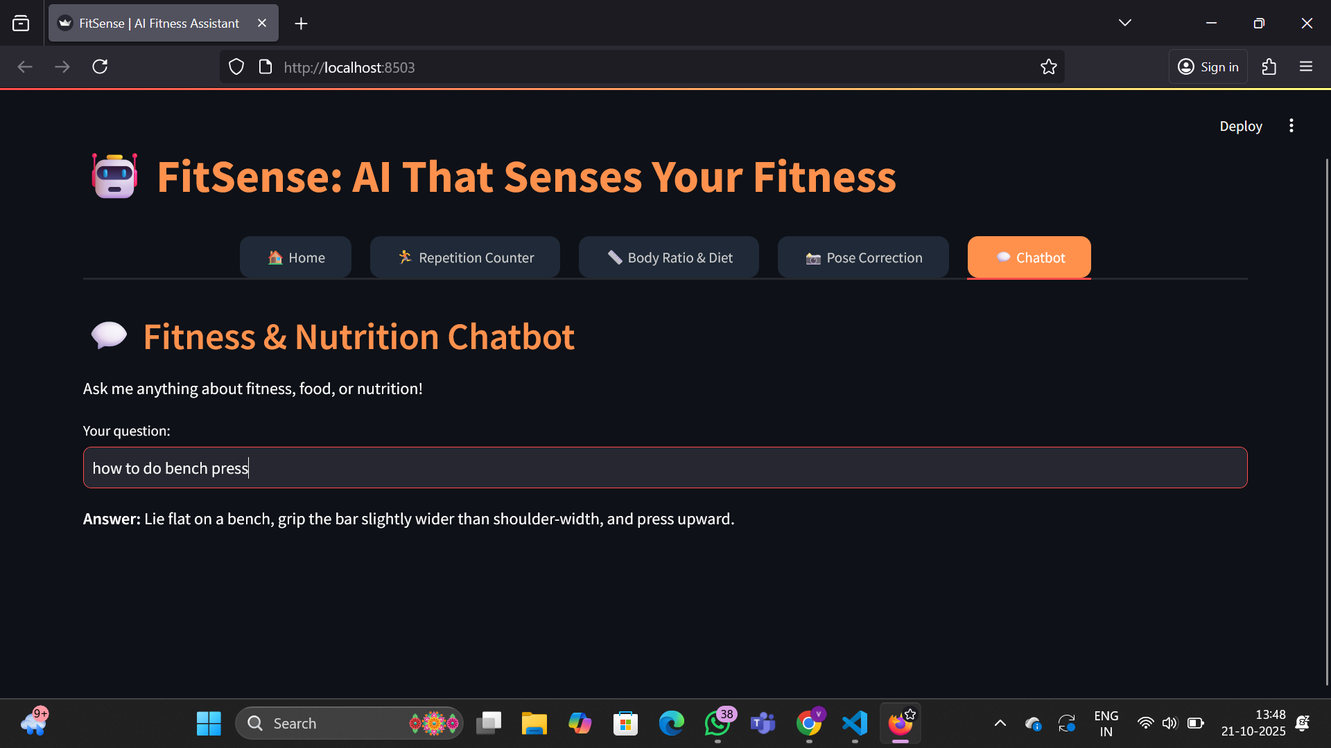
ChatBot
This will provides Answers for both fitness and nutrition related questions.

Slide 17
